Slide 1

Minimizing Entropy for Training and Quantization (METaQ):
A Novel Algorithm for Neural Network Training and Compression

Slide 2
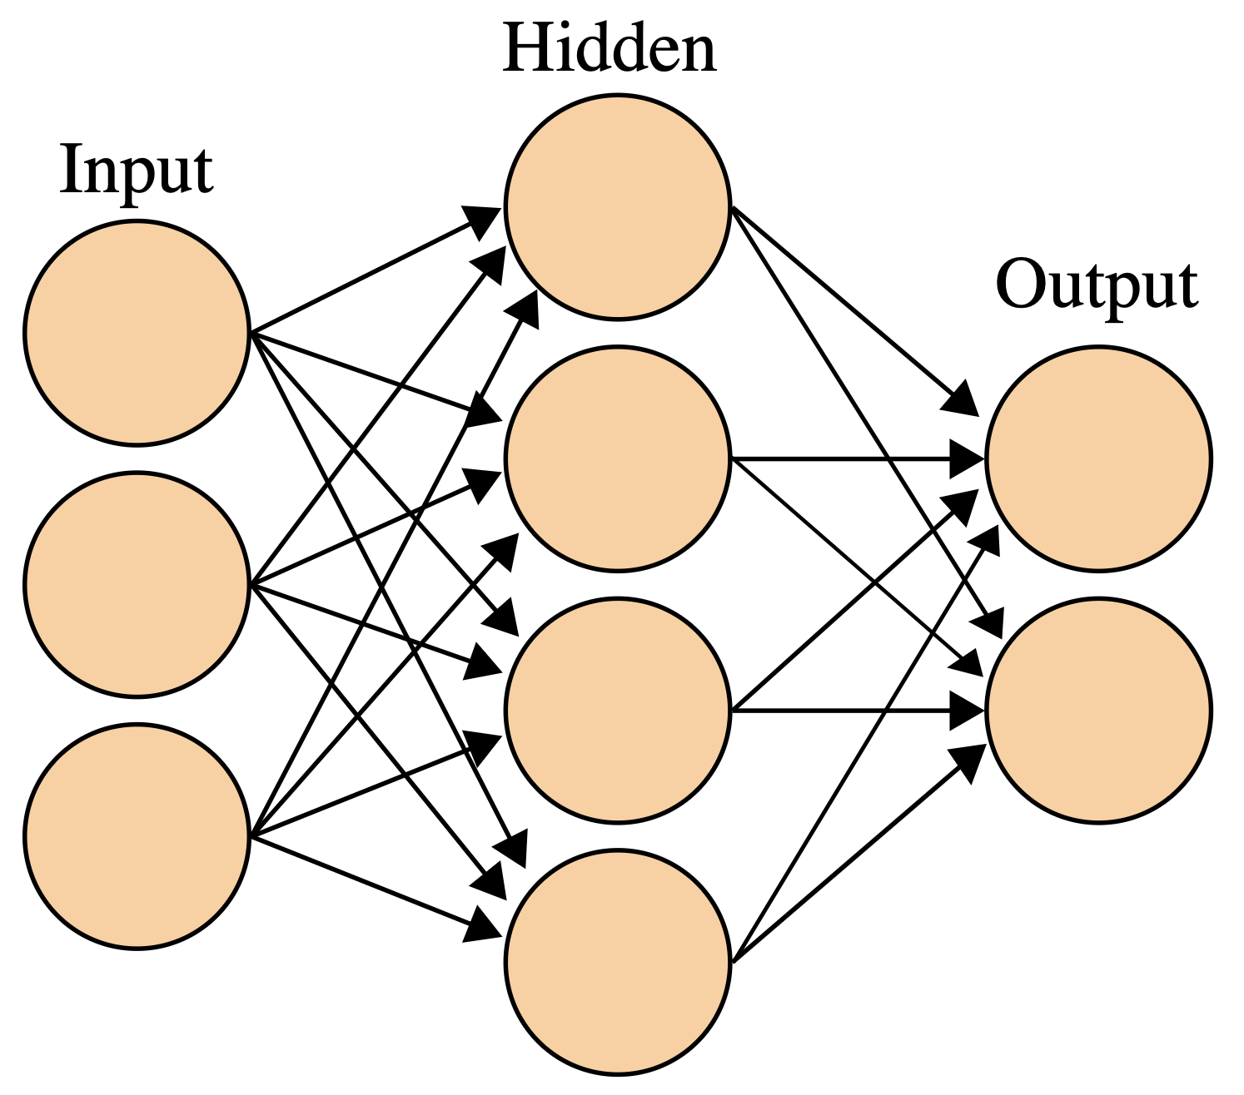
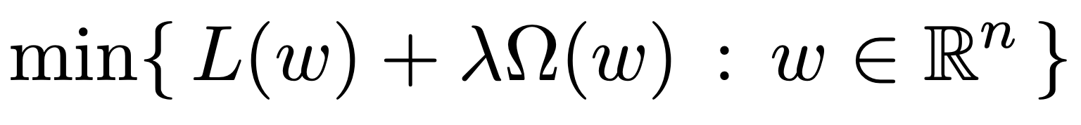
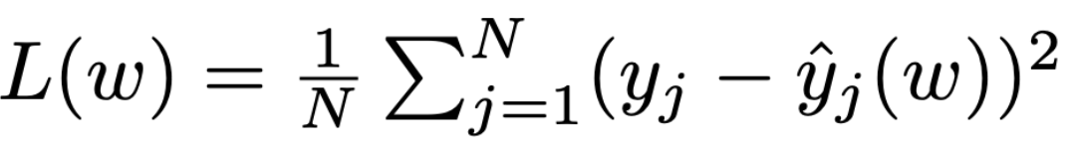
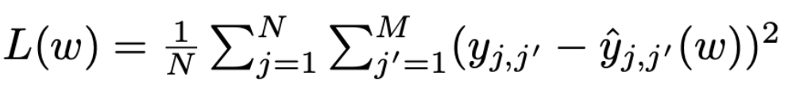
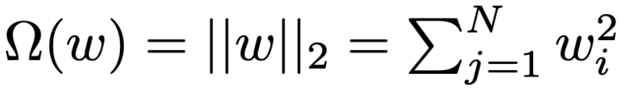
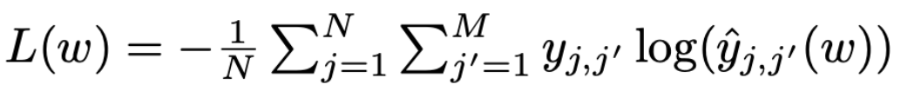


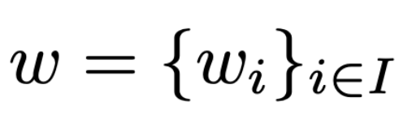
Neural Networks: Quick Introduction
General Optimization Problem
x_{i}
y_{i}
Each connection from node a and node b has a weight w_{a,b}, and network training consists of adjusting these weights
For semplicity we can imagine an unstructured vector of weights:
Hyperparameter | Meaning
λ | Coefficient of the total regularization

Slide 3
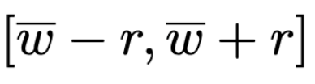

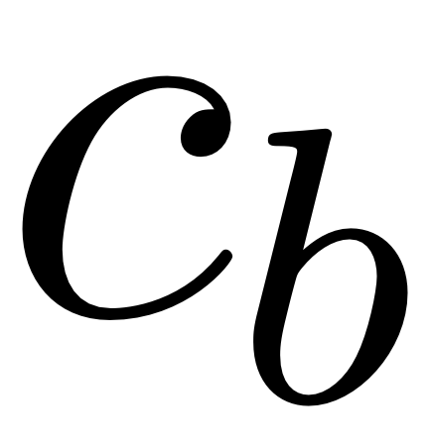

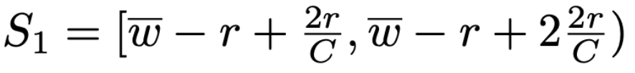
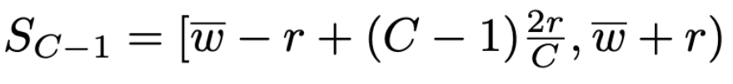


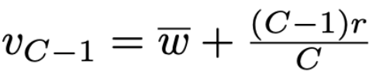

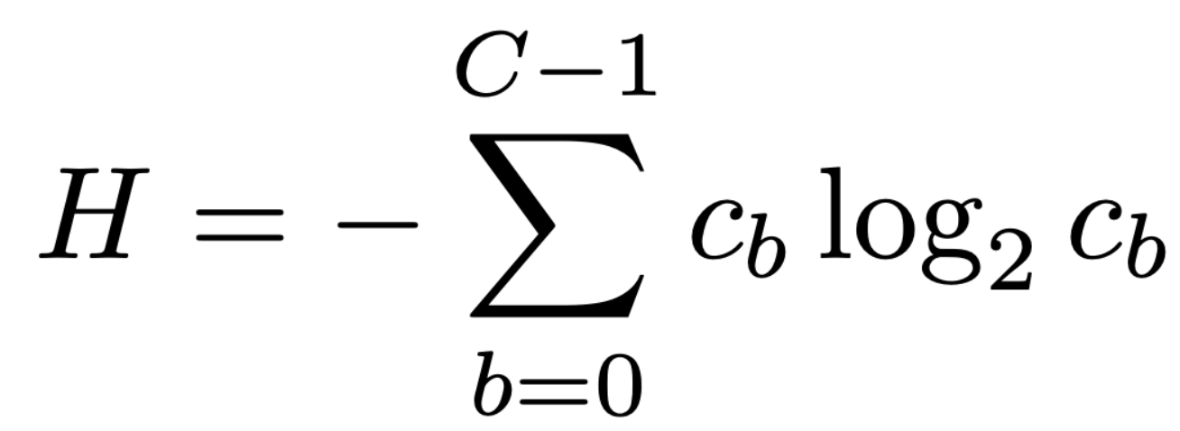
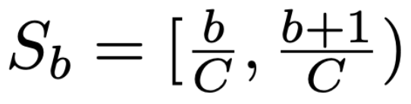
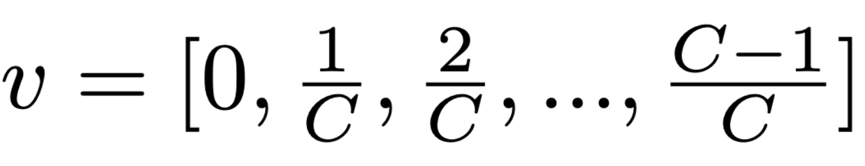
Buckets organization
1/C
{
C buckets
Number of weights falling in
bucket b where b = 0,..., C-1
Hyperparameter | Meaning
λ | Coefficient of the total regularization
C | Number of buckets
 | Central value around which the weights are initialized
r | Radius of initialization of weights
If = r = 0.5 then:

Slide 4
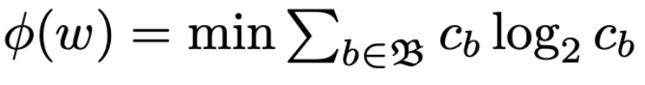
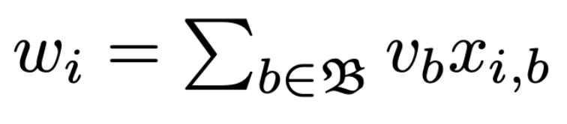

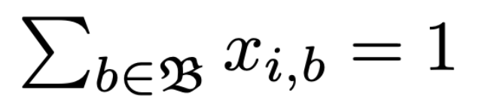
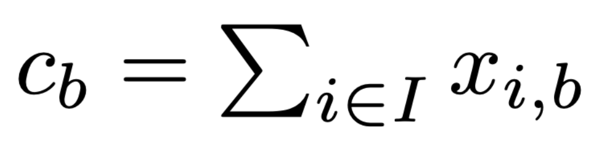

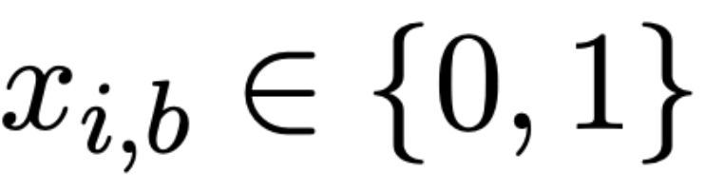

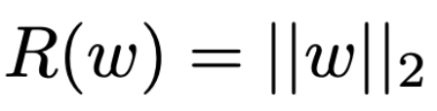
METaQ Problem
(1)
(2)
(3)
(4)
(5)
Hyperparameter | Meaning
λ | Coefficient of the total regularization
C | Number of buckets
 | Central value around which the weights are initialized
r | Radius of initialization of weights
⍺ | Percentage of standard vs total regularization

Slide 5

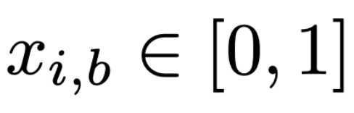
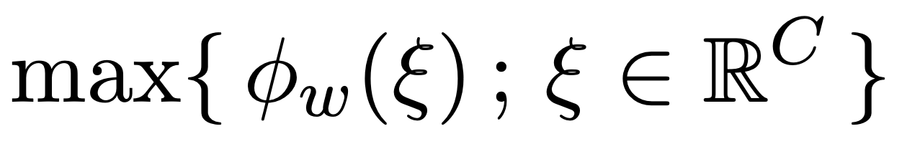
The aim is to find ∇ɸ(w)
(5)
Th: ∇ɸ(w) is given by the optimal lagrangian multipliers β* associated with constraint (2)
(6)
To find these multipliers, let us relax the constraints (4)
And let us solve the dual lagrangian problem

Slide 6
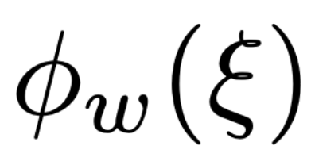
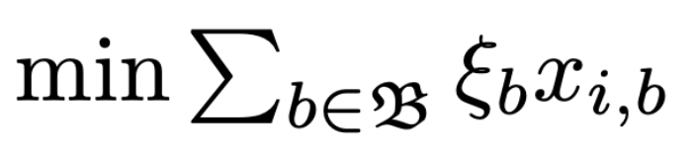
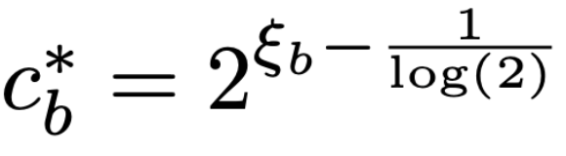
Construction of
Hyperparameter | Meaning
λ | Coefficient of the total regularization
C | Number of buckets
 | Central value around which the weights are initialized
r | Radius of initialization of weights
⍺ | Percentage of standard vs total regularization
c | Lower bound for c_{b}*
c | Upper bound for c_{b}*
Two independent subproblems:
c = 1e-2
c = |I|

Slide 7
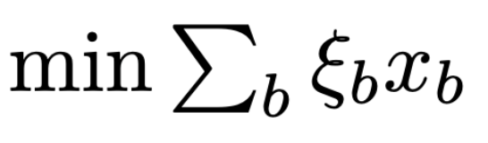
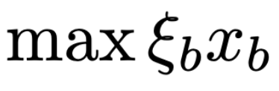
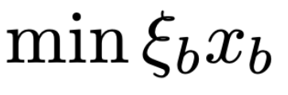
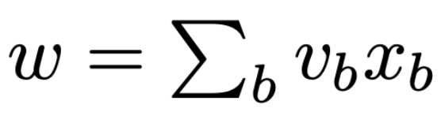
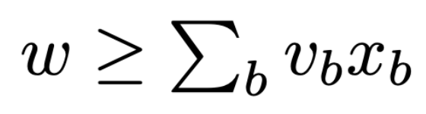
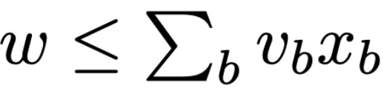
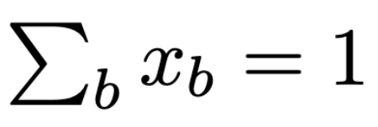
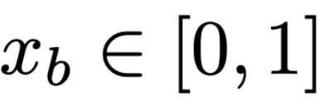
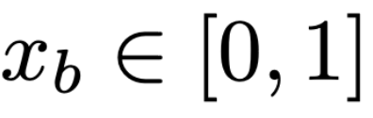
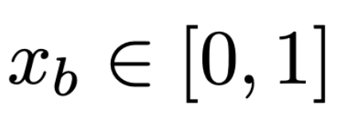
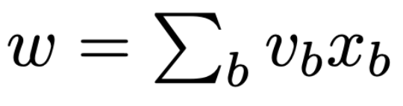
Knapsack Problem (common variants)
In solving this problem, we will assume that ξ and v are ordered.
OPTION 0: Solver (e.g. CVXPY)
Problem: too slow
OPTION 1: Cutting Plane Algorithm
Problem: might not be fast enough
OPTION 2: Specialized Algorithm

Slide 8
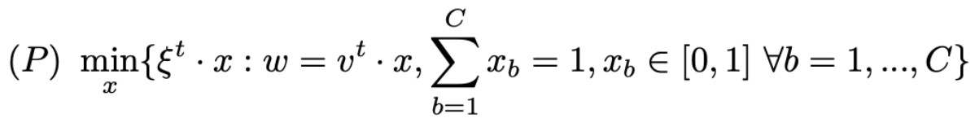



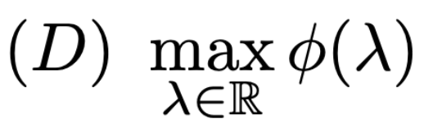
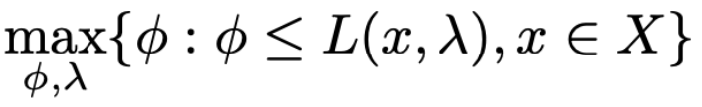

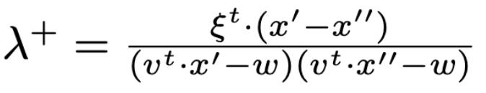
OPTION 1: Cutting Plane Algorithm
Primal Problem
Lagrangian Function
,
Dual Function
Dual Problem
⇔
Master Problem
⇒

Slide 9

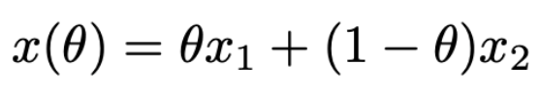

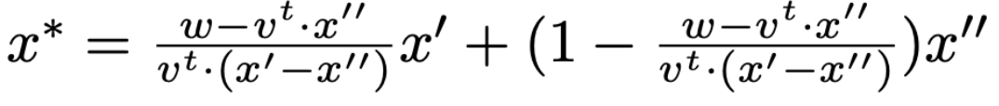
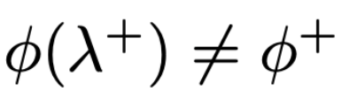
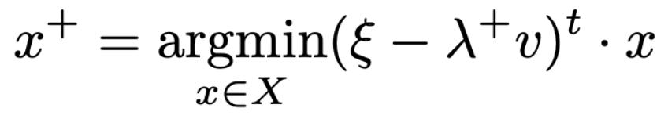
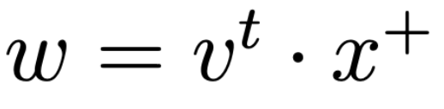
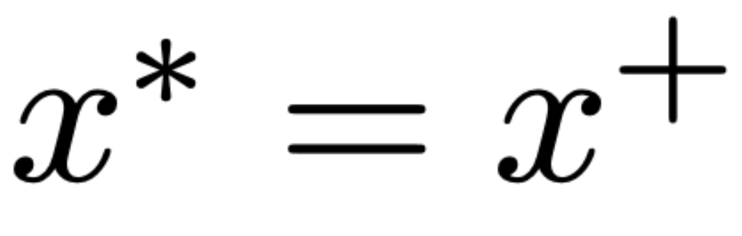
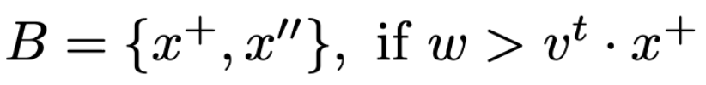
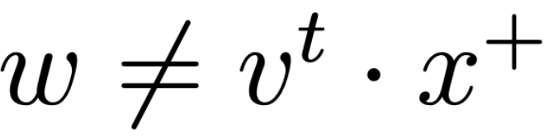

⇒
⇒
⇒
⇒
Master Problem
Performance:
The standard version is 15.95x faster than CVXPY
The vectorized version is 2378x faster than CVXPY

Slide 10
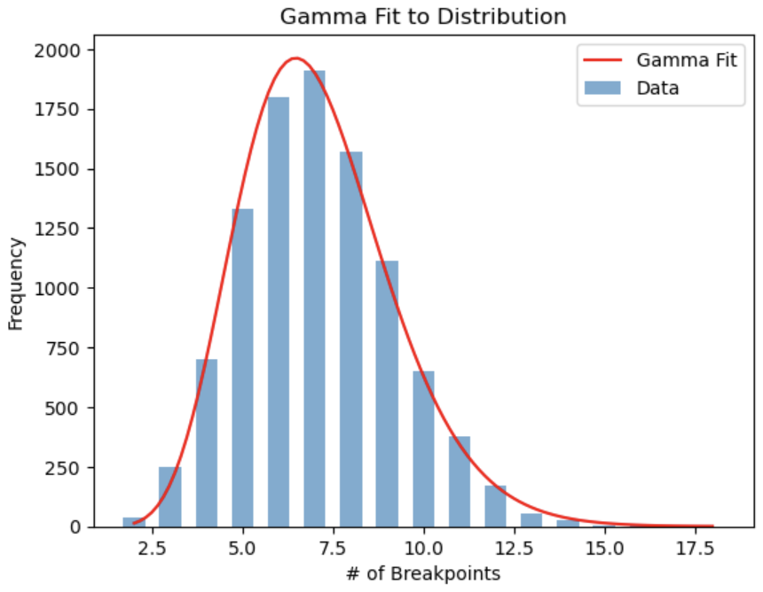


OPTION 2: Specialized Algorithm
10000 simulations
Idea: λ → -∞
= [1,0,0,..,0]
λ → +∞
= [0,0,..,0,1]
The estimated probability of having 256 breakpoints for C = 256 is 1.82e-157
Increasing λ from -∞ to +∞ the minimum component shifts to the right
(C = 15)
We calculate the vector of breakpoints [O(C²)]
Depending on the value of w_{i} we compute idx_left and idx_right [O(log(C))]
We construct the convex combination between the vectors with active components idx_left and idx_right [O(1)]
Special cases: w <= v[0] and w >= v[-1] [O(1)]
[1,0,0,1,1,0,1,0,0,0,1,1,0,1,1]
Breakpoints
Performance:
11.58x faster than Cutting Plane Algorithm Vectorized
27539x faster than CVXPY
Depending on the value w_{i}, we take the appropriate convex combination which corresponds to the appropriate λ

Slide 11







Up to this point we have fully defined as a function of ξ:
At ξ* (or at an approximation ξ of it), we will have solved:
and thus computed an approximation for β* = ∇ɸ
Sub-gradient (Super-gradient) Methods:
➛ Diminishing-Square Summable Stepsize
➛ FISTA
(Fast Iterative Shrinkage-Threshold Algorithm)
Th:
Th: With
the algorithm converges

Slide 12





Bundle Methods:
➛ Proximal BM
➛ Trust Region stabilization
➛ Level stabilization
➛ Center-based
approaches
➛ etc.
Hyperparameter | Meaning
λ | Coefficient of the total regularization
C | Number of buckets
 | Central value around which the weights are initialized
r | Radius of initialization of weights
⍺ | Percentage of standard vs total regularization
𝛇 | Convergence step sub-gradient / bundle method
B_{s} | Bundle size
Bundle B^{(k)} of size B_{s} = 20

Slide 13

Quantization
Network Compression
Huffman Coding
Arithmetic Coding
gzip-9
zstd-22
Once the training is completed, the weights are not exactly quantized, but they are close to their corresponding values in v.
The training has prepared them for quantization.
At this point, each weight can be assigned to its reference value v_{b}.
s: sequence to be compressed, of length n, with elements s_{i} where i = 1,...,n u: sequence of unique values (symbols) in s, with A elements u_{a} where a = 1,...,A
We compress the sequence s using one of the aforementioned compression algorithms using the frequencies of u in the case of statistical methods, or otherwise based on the order in which the symbols occur in the other two cases.

Slide 14


Tests & Results
REFERENCE | COMPRESSION RATIO
Improvement of pruning method for convolution neural network compression [C Liu and Q Liu, 2018] | 9.47% (10.56x)
TR-Nets [Wang et al., 2018] | 9.09% (11x)
Neuron Pruning for Compressing Deep Networks Using Maxout Architectures [Rueda et al., 2017] | 8% (12.5x)
EDCompress [Zhehui Wang et al., 2021] | 3.85% (26x)
METaQ | 3.43% (29x)
Deep Compression [Han et al., 2016] | 2.56% (39x)
Deep model compression based on the training history [Basha et al., 2024] | 2.02% (49.5x)
DeepSZ [Jin et al., 2019] | 1.79% (56x)
LeNet-5
By Zhang, Aston and Lipton, Zachary C. and Li, Mu and Smola, Alexander J.
https://github.com/d2l-ai/d2l-en, CC BY-SA 4.0, https://commons.wikimedia.org/w/index.php?curid=152265656
MNIST
https:/en.wikipedia.org/wiki/MNIST_database

Slide 15
Challenges and Possible Future Developments
Substitute ||w||₂ with other regularization techniques (e.g. SPR)
Different BM
Explore the wide range of hyperparameters with supercomputers
Explore different network architectures

Slide 16
Thanksgiving
I would like to thank my Professors, who gave me the opportunity, through their ideas and insights, to be able to work on this project, which is as innovative and topical as it is stimulating and engaging, allowing me to interface with cutting-edge research work and technologies in a rapidly changing world.
But most of all, I thank my mom, who gave me the opportunity to graduate and build the person I am.

